Slide 1
Programming II
(C Programming Language)
Unions in C
Lecture 17, Monday April 12, 2021
Dr. Ayman ALJARBOUH

Slide 2
Outline
Defining a Union
Accessing Union Members
Difference Between Unions and Structures
Typedef
typedef versus #define
Create Union Variables

Slide 3
C Programming Unions
A union is a user-defined type similar to structures in C programming
A union is a special data type that enables you to store different data types in the same memory location
You can define a union with many members, but only one member can contain a value at any given time
Unions provide an efficient way of using the same memory location for multi-purpose

Slide 4
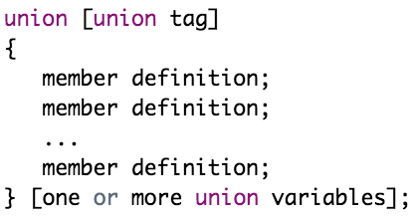
Defining a Union
To define a union, you must use the keyword union in very similar was as you did while defining structure. The syntax is:
Note that:
The union tag is optional
Each member definition is a variable definition, such as int i; or float f; or any other valid variable definition
At the end of the union's definition, before the final semicolon, you can specify one or more union variables but it is optional

Slide 5
Outline
Defining a Union
Accessing Union Members
Difference Between Unions and Structures
Typedef
typedef versus #define
Create Union Variables

Slide 6
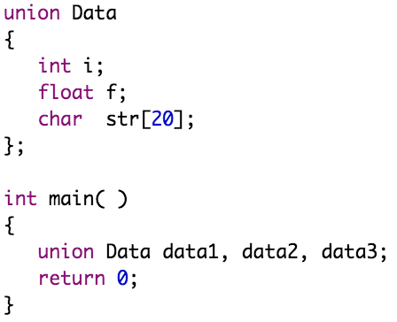
Create Union Variables
When a union is defined, it creates a user-defined type. No memory is allocated
To allocate memory for a given union type and work with it, we need to create variables

Slide 7
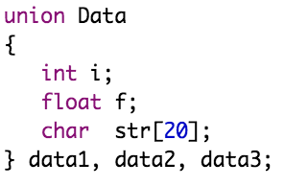
Create Union Variables
When a union is defined, it creates a user-defined type. No memory is allocated
To allocate memory for a given union type and work with it, we need to create variables
In both cases, union variables data1, data2, and data3 of union Data type are created, and the union Data can store an integer, a floating-point number, or a string of characters

Slide 8
Create Union Variables
When a union is defined, it creates a user-defined type. No memory is allocated
To allocate memory for a given union type and work with it, we need to create variables
The memory occupied by a union will be large enough to hold the largest member of the union. Here, union Data will occupy 20 bytes of memory space because this is the maximum space which can be occupied by character string

Slide 9
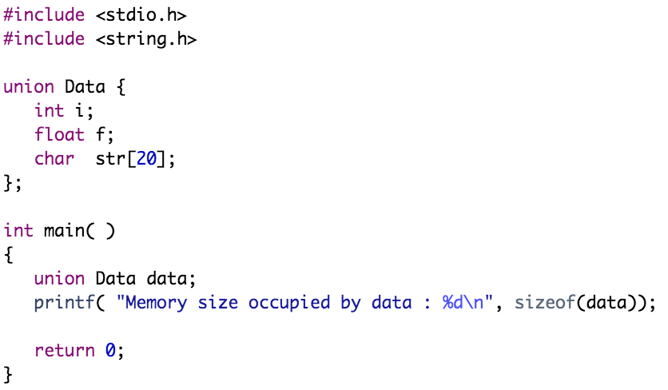
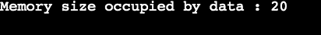
Create Union Variables
Following is the example which will display total memory size occupied by the above union
Example:

Slide 10
Outline
Defining a Union
Accessing Union Members
Difference Between Unions and Structures
Typedef
typedef versus #define
Create Union Variables

Slide 11
Accessing Union Members
To access any member of a union, we use the member access operator (.)
The member access operator is coded as a period between the union variable name and the union member that we wish to access
Important Note: Only one union member can be accessed at a time. When using structures, you can access all members of a structure at once as sufficient memory is allocated for all members. However, it's not the case in unions. You can only access a single member of a union at one time. Following are examples to explain this issue

Slide 12
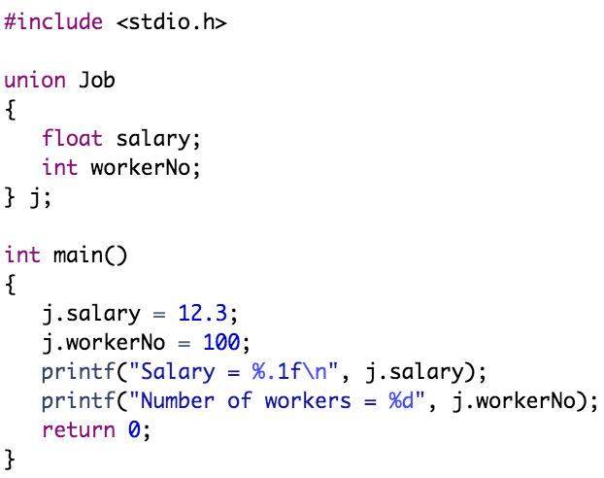
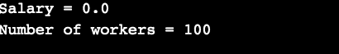
Accessing Union Members
Example:
Notice that 12.3 was not stored in j.salary. Here, we can see that values of salary member of union got corrupted because final value assigned to the union variable j.workerNo has occupied the memory location and this is the reason that the value of workerNo member of union is getting printed correctly.

Slide 13
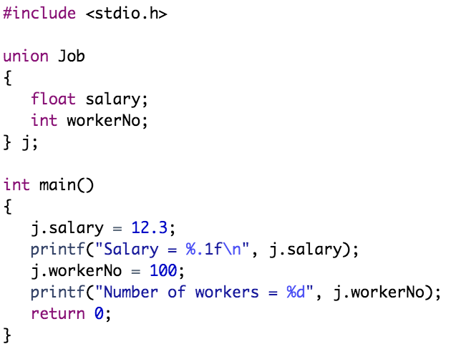
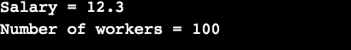
Accessing Union Members
Example (Revisited):
Here, all the members are getting printed very well because one member is being used at a time

Slide 14
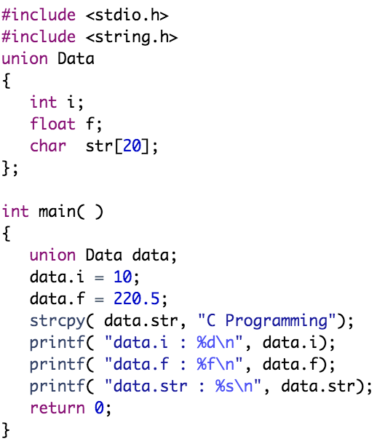
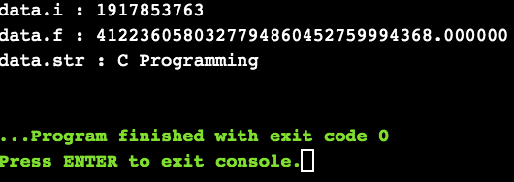
Accessing Union Members
Example:
Here, we can see that values of i and f members of union got corrupted because final value assigned to the union variable data.str has occupied the memory location and this is the reason that the value of str member of union is getting printed correctly.

Slide 15
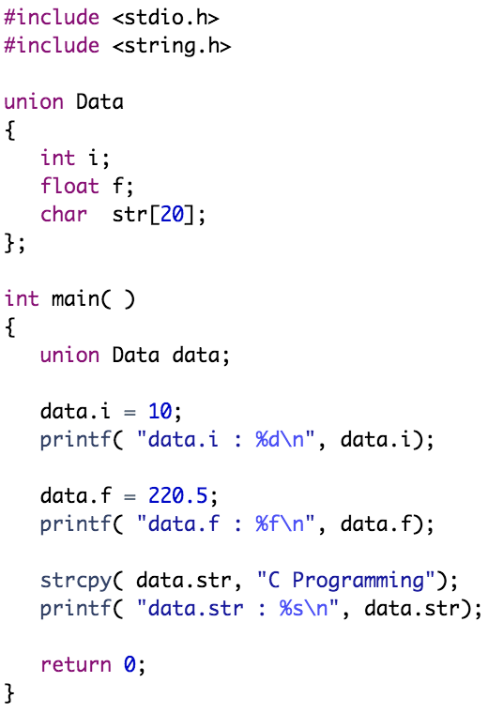
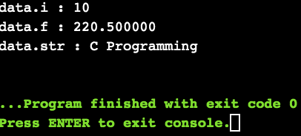
Example (Revisited):
Here, all the members are getting printed very well because one member is being used at a time

Slide 16
Outline
Defining a Union
Accessing Union Members
Difference Between Unions and Structures
Typedef
typedef versus #define
Create Union Variables

Slide 17
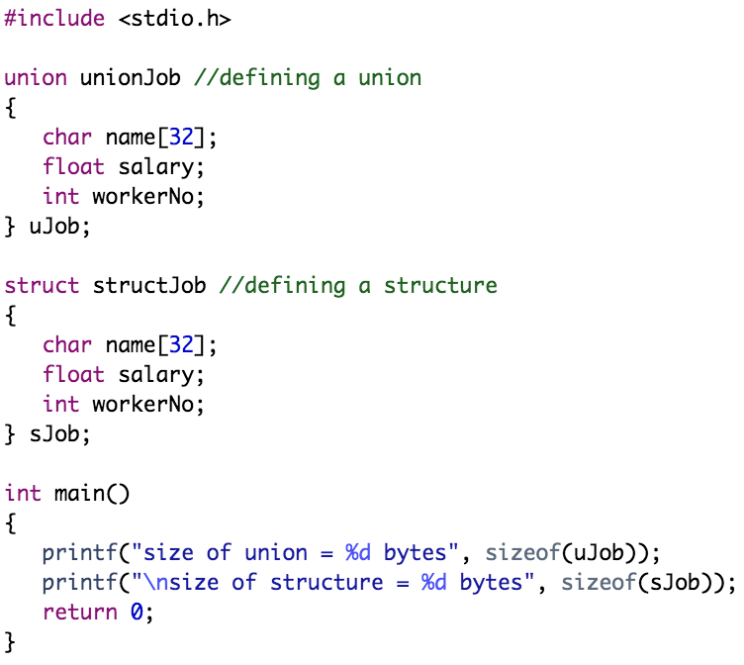
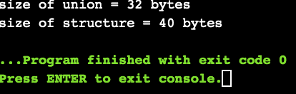
Difference Between Unions and Structures
Let's take an example to demonstrate the difference between unions and structures
Why this difference in the size of union and structure variables?
The size of the structure variable sJob is 40 bytes because
the size of name[32] is 32 bytes,
the size of salary is 4 bytes ,
the size of workerNo is 4 bytes.

Slide 18
Difference Between Unions and Structures
Let's take an example to demonstrate the difference between unions and structures
Why this difference in the size of union and structure variables?
However, the size of the union variable uJob is 32 bytes. It's because the size of a union variable will always be the size of its largest element. In the above example, the size of its largest element, (name[32]), is 32 bytes.

Slide 19
Difference Between Unions and Structures
Let's take an example to demonstrate the difference between unions and structures
Note that: The same as for structures, you can also pass union variables as arguments to a function, return union from a function, and use pointers to access members of unions

Slide 20
Outline
Defining a Union
Accessing Union Members
Difference Between Unions and Structures
Typedef
typedef versus #define
Create Union Variables

Slide 21

Typedef
The C programming language provides a keyword called typedef, which you can use to give a type a new name
Following is an example to define a term BYTE for one-byte numbers:
After this type definitions, the identifier BYTE can be used as an abbreviation for the type
By convention, uppercase letters are used for these definitions to remind the user that the type name is really a symbolic abbreviation, but you can use lowercase, as follows:

Slide 22
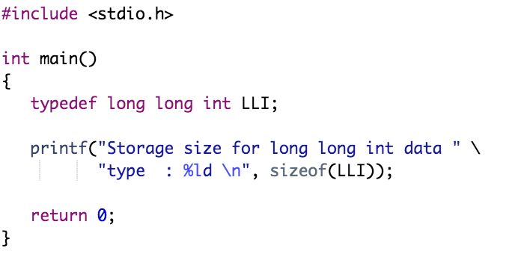
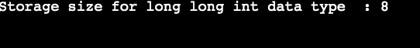
Typedef
Following is an example that shows the usage of typedef
Example:

Slide 23
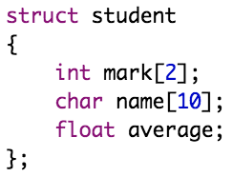
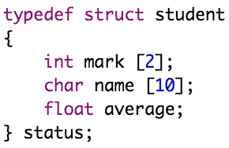
Typedef
You can use typedef with structure to define a new data type and then use that data type to define structure variables directly
For example, consider the following structure
An alternative way for structure declaration using typedef:

Slide 24
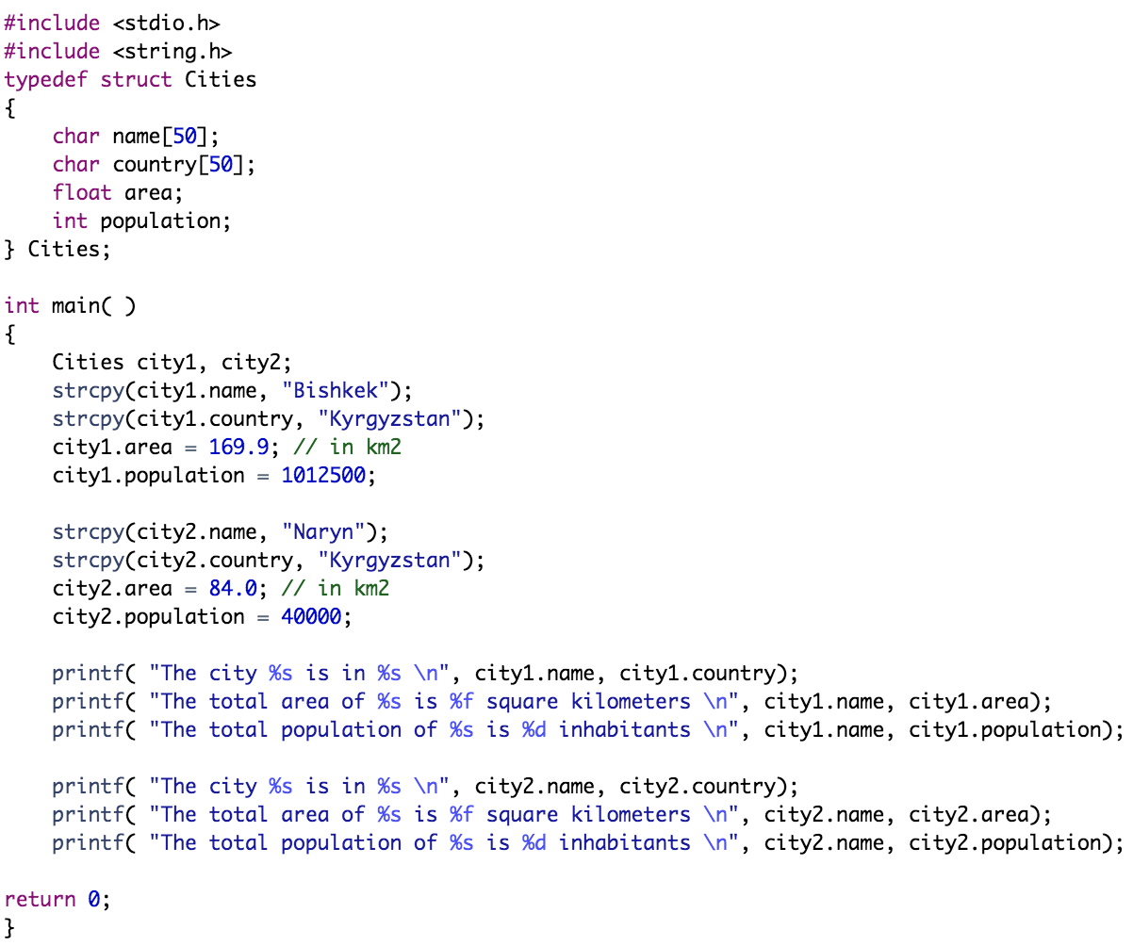
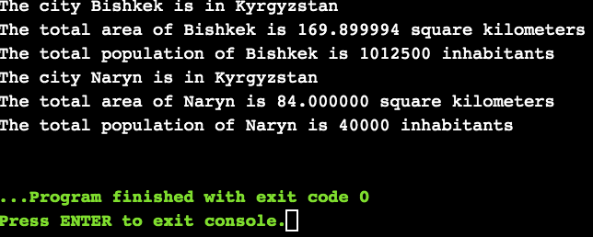
Example:

Slide 25
Outline
Defining a Union
Accessing Union Members
Difference Between Unions and Structures
Typedef
typedef versus #define
Create Union Variables

Slide 26
typedef versus #define
The #define is a C-directive which is also used to define the aliases for various data types similar to typedef, but with three differences:
The typedef is limited to giving symbolic names to types only, where as #define can be used to define alias for values as well, like you can define 1 as ONE etc
The typedef interpretation is performed by the compiler where as #define statements are processed by the pre-processor

Slide 27
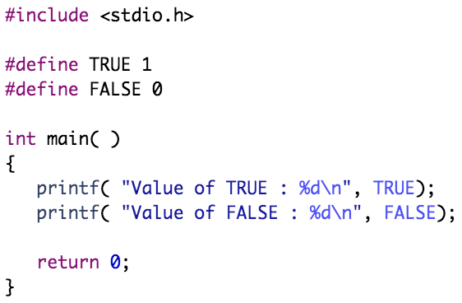
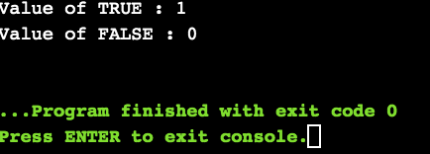
typedef versus #define
Example:

Slide 28
Practical Exercises
Write and Compile the following C programs:
Program 1:

Slide 29
Practical Exercises
Write and Compile the following C programs:
Program 2:

Slide 30
Program 3:

Slide 31
Practical Exercises
Write and Compile the following C programs:
Program 4:

Slide 32
Practical Exercises
Write and Compile the following C programs:
Program 5:

